Slide 1
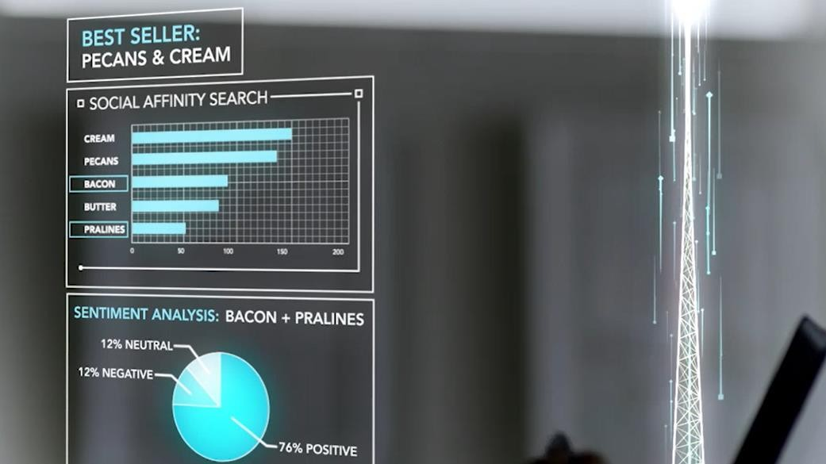

Evening GL Team!
Mrinal Chakraborty
Cloud Sol. Architect (AI)
Mrinal.Chakraborty@Gmail.com
Programing: SAS, CNTK, TensorFlow R-Server and Scala
Big-Data: Cloudera Hadoop certification and Spark Ecosystem
Machine learning: Logistic Regression, Neural Networks, Support vector machines, XGBoost, Classification and Association rules
Allied Analytics skills: Visualisation, Marketing & Web analytics
Certifications: PMP, Design Thinking, Certified Scrum Master & Certified in Business analytics from Indian School of Business
Thanks to Brandon Rohrer for the content

Slide 2
What‘s in for today ?
Vision API Demo
Demo of Vision API
What could be its applications?
Introduction to Cognitive services
Shall we understand the concepts?
Most popular: CNN and Stacking
CNTK + TensorFlow -> Now you know the platforms
Schematic Explanation of DNN
Lift the Hood ! DNN action
Logistical Regression to CNN with CNTK
Repository and self-learn
Find all the resources @ https://github.com/Mrinal4Github/Great_Learning

Slide 3
Overview: Deep Neural Networks

Slide 4
TL;DR
Deep learning isn’t magic.
But it is very good at finding patterns.
Notes:
You

Slide 5
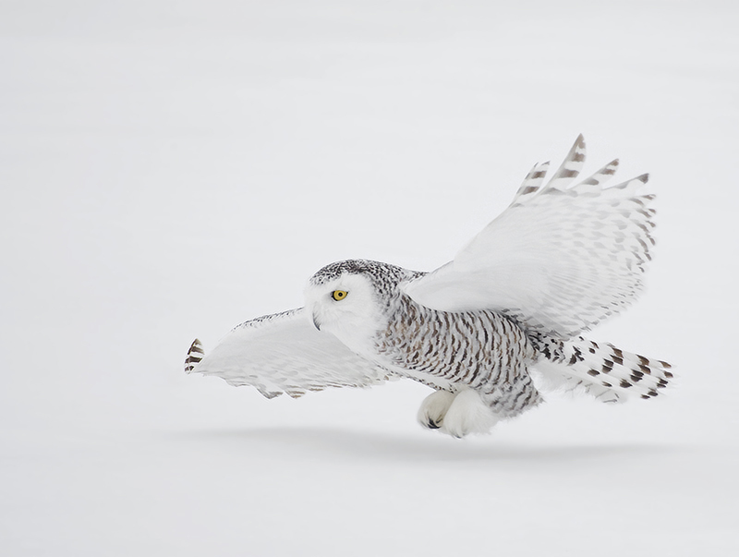
The brain and deep learning
Creative Commons 3

Slide 6
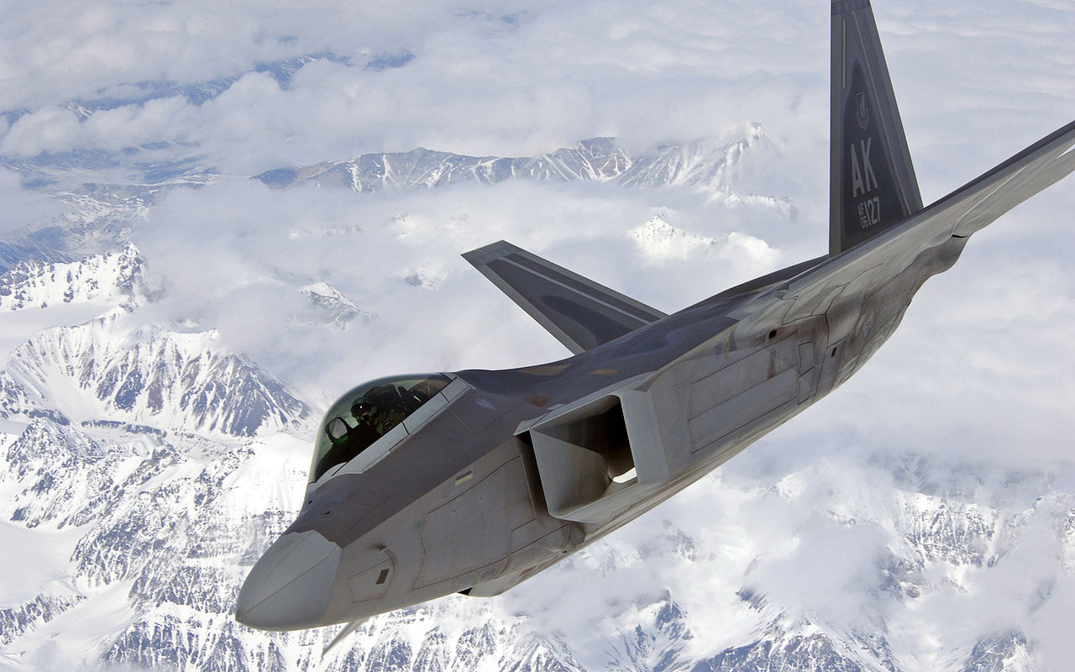
The brain and deep learning
Creative Commons 3
David Hemmings
public domain

Slide 7
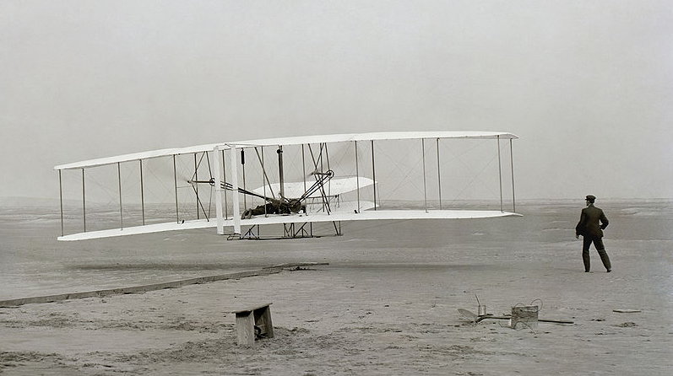
public domain

Slide 8
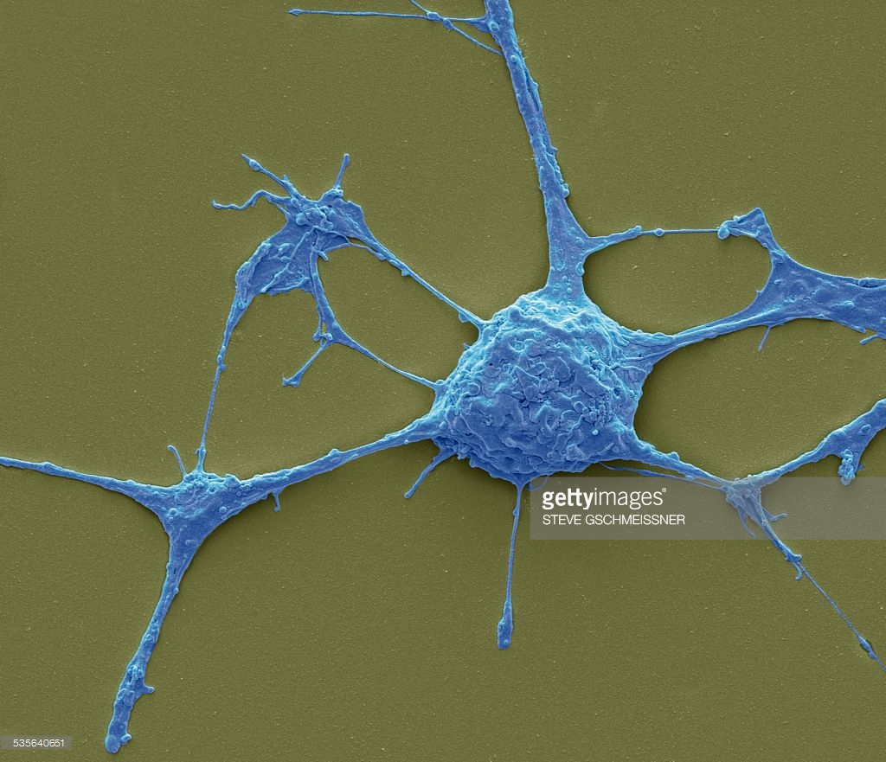
neuron

Slide 9
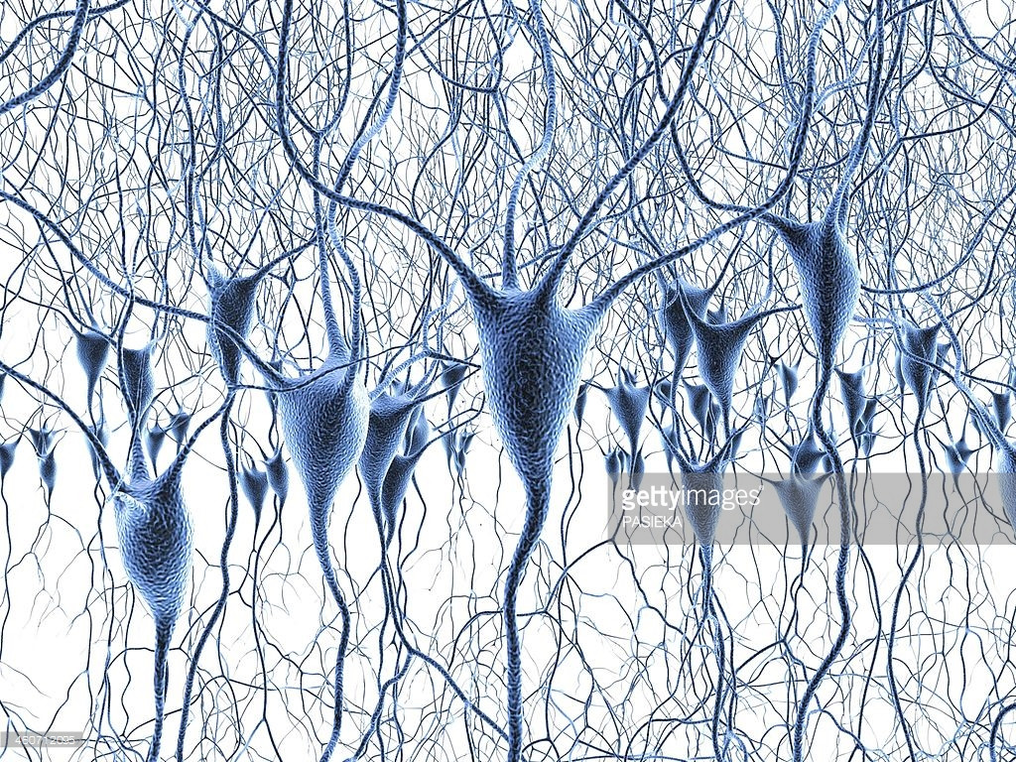
neural network

Slide 10
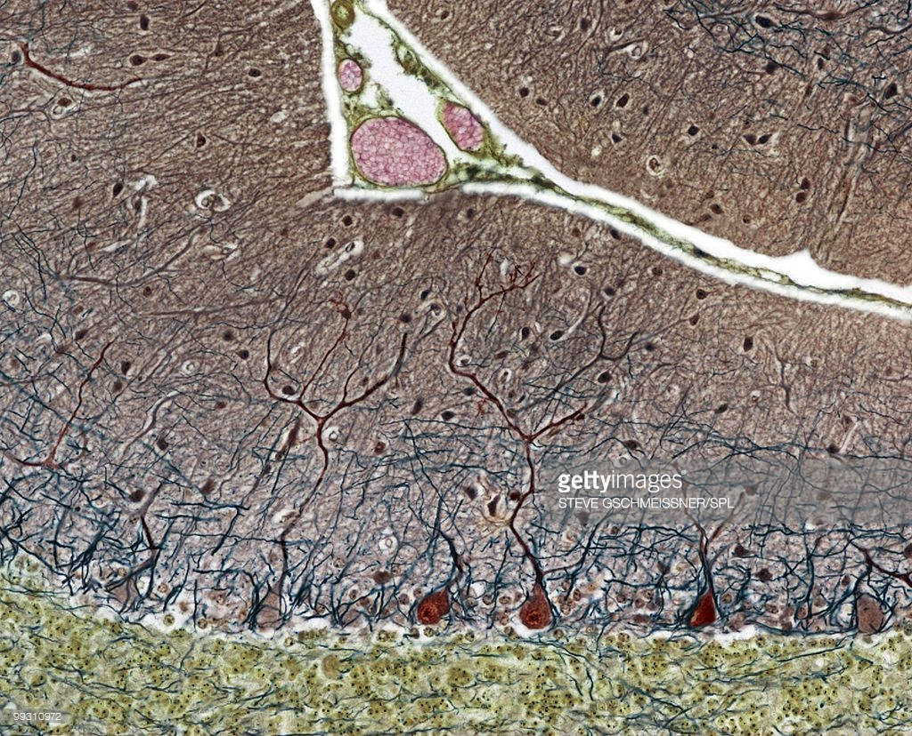
neural network

Slide 11
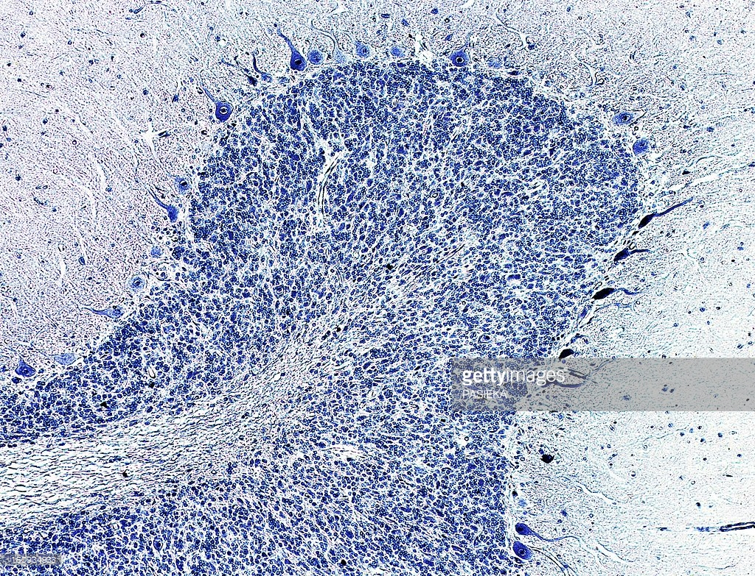
neural network

Slide 12
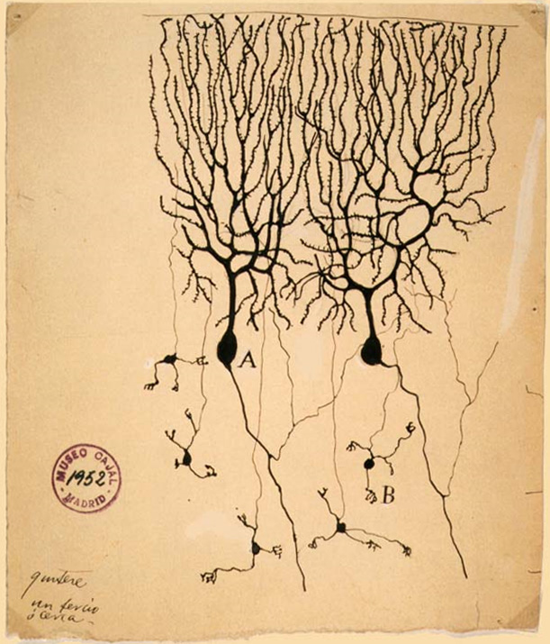
Neurons
Drawing of
Purkinje cells (A) and
granule cells (B) from pigeon cerebellum by
Santiago Ramón y Cajal,
1899; Instituto Cajal,
Madrid, Spain
Public domain

Slide 14
axon
soma
dendrites

Slide 15
axon
soma
dendrites

Slide 16
Soma adds dendrite activity together and passes it to axon.
+

Slide 17
More dendrite activity makes more axon activity
+

Slide 18
+

Slide 19

Synapse
Connection between axon of one neuron and dendrites of another
synapse

Slide 20
Synapse
Connection between axon of one neuron and dendrites of another

Slide 21
Synapse
Connection between axon of one neuron and dendrites of another

Slide 23
Axons can connect to dendrites strongly, weakly, or somewhere in between.

Slide 24
Medium connection (.6)

Slide 25
Strong connection (1.0)

Slide 26
Weak connection (.2)
No connection is a 0.

Slide 27
Lots of axons connect with the dendrites of one neuron.
Each has its own connection strength.

Slide 29
.5
.8
.3
.2
.9

Slide 30
.5
.8
.3
.2
.9

Slide 33
ACE
A
B
C
D
E

Slide 35
eyeball
eye
sun
ball
glasses

Slide 36
sunglasses
eyeball
eye
sun
ball
glasses

Slide 37
sunglasses
eyeball
eyeglasses
eye
sun
ball
glasses

Slide 38
Each node represents a pattern, a combination of the neurons on the previous layer.
first layer
inputs

Slide 39
Deep network
third layer
If a network has more than three layers, it’s deep.
Some 12 or more.
second
layer
first layer
inputs

Slide 40
A toy ConvNet: X’s and O’s
Says whether a picture is of an X or an O
A two-dimensional
array of pixels
CNN
X or O

Slide 41
For example
CNN
X
CNN
O

Slide 42
Trickier cases
CNN
X
translation
scaling
rotation
weight
CNN
O

Slide 43
Deciding is hard
?
=

Slide 44
What computers see
?
=

Slide 45
What computers see

Slide 46
Computers are literal
=
x

Slide 47
ConvNets match pieces of the image
=
=
=

Slide 48
Features match pieces of the image

Slide 54
Filtering: The math behind the match

Slide 55
Filtering: The math behind the match
Line up the feature and the image patch.
Multiply each image pixel by the corresponding feature pixel.
Add them up.
Divide by the total number of pixels in the feature.

Slide 56
Filtering: The math behind the match
1 x 1 = 1

Slide 57
Filtering: The math behind the match
1 x 1 = 1

Slide 58
Filtering: The math behind the match
-1 x -1 = 1

Slide 59
Filtering: The math behind the match
-1 x -1 = 1

Slide 60
Filtering: The math behind the match
-1 x -1 = 1

Slide 61
Filtering: The math behind the match
1 x 1 = 1

Slide 62
Filtering: The math behind the match
-1 x -1 = 1

Slide 63
Filtering: The math behind the match
-1 x -1 = 1

Slide 64
Filtering: The math behind the match
-1 x -1 = 1

Slide 65
Filtering: The math behind the match
1 x 1 = 1

Slide 66

Filtering: The math behind the match
$$\frac{1+1+1+1+1+1+1+1+1}{9}=1$$

Slide 67
Filtering: The math behind the match
1 x 1 = 1

Slide 68
Filtering: The math behind the match
-1 x 1 = -1

Slide 69
Filtering: The math behind the match

Slide 70

Filtering: The math behind the match
$$\frac{1+1−1+1+1+1−1+1+1}{9}=.55$$
.55

Slide 71
Convolution: Trying every possible match

Slide 72
Convolution: Trying every possible match
=

Slide 73
=
=
=

Slide 74
Convolution layer
One image becomes a stack of filtered images

Slide 75
Convolution layer
One image becomes a stack of filtered images

Slide 76
Pooling: Shrinking the image stack
Pick a window size (usually 2 or 3).
Pick a stride (usually 2).
Walk your window across your filtered images.
From each window, take the maximum value.

Slide 77
Pooling
maximum

Slide 78
Pooling
maximum

Slide 79
Pooling
maximum

Slide 80
Pooling
maximum

Slide 81
Pooling
maximum

Slide 82
Pooling
max pooling

Slide 84
Pooling layer
A stack of images becomes a stack of smaller images.

Slide 85
Normalization
Keep the math from breaking by tweaking each of the values just a bit.
Change everything negative to zero.

Slide 86
Rectified Linear Units (ReLUs)

Slide 87
Rectified Linear Units (ReLUs)

Slide 88
Rectified Linear Units (ReLUs)

Slide 89
Rectified Linear Units (ReLUs)

Slide 90
ReLU layer
A stack of images becomes a stack of images with no negative values.

Slide 91
Layers get stacked
The output of one becomes the input of the next.
Convolution
ReLU
Pooling

Slide 92
Deep stacking
Layers can be repeated several (or many) times.
Convolution
ReLU
Convolution
ReLU
Pooling
Convolution
ReLU
Pooling

Slide 93
Fully connected layer
Every value gets a vote

Slide 94
Fully connected layer
Vote depends on how strongly a value predicts X or O
X
O

Slide 95
Fully connected layer
Vote depends on how strongly a value predicts X or O
X
O

Slide 96
Fully connected layer
Future values vote on X or O
X
O

Slide 97
Fully connected layer
Future values vote on X or O
X
O

Slide 98
Fully connected layer
Future values vote on X or O
X
.92
O

Slide 99
Fully connected layer
Future values vote on X or O
X
.92
O

Slide 100
Fully connected layer
Future values vote on X or O
X
.92
O
.51

Slide 101
Fully connected layer
Future values vote on X or O
X
.92
O
.51

Slide 102
Fully connected layer
A list of feature values becomes a list of votes.
X
O

Slide 103
Fully connected layer
These can also be stacked.
X
O

Slide 104
Putting it all together
A set of pixels becomes a set of votes.
.92
X
Convolution
ReLU
Fully
connected
Fully
connected
Convolution
ReLU
Convolution
ReLU
Pooling
Pooling
O
.51

Slide 105
Learning
Q: Where do all the magic numbers come from?
Features in convolutional layers
Voting weights in fully connected layers
A: Backpropagation

Slide 106
Backprop
Error = right answer – actual answer
.92
X
Convolution
ReLU
Fully
connected
Fully
connected
Convolution
ReLU
Convolution
ReLU
Pooling
Pooling
O
.51

Slide 107
Backprop
.92
X
Convolution
ReLU
Fully
connected
Fully
connected
Convolution
ReLU
Convolution
ReLU
Pooling
Pooling
O
.51

Slide 108
Backprop
.92
X
Convolution
ReLU
Fully
connected
Fully
connected
Convolution
ReLU
Convolution
ReLU
Pooling
Pooling
O
.51

Slide 109
Backprop
.92
X
Convolution
ReLU
Fully
connected
Fully
connected
Convolution
ReLU
Convolution
ReLU
Pooling
Pooling
O
.51

Slide 110
Backprop
.92
X
Convolution
ReLU
Fully
connected
Fully
connected
Convolution
ReLU
Convolution
ReLU
Pooling
Pooling
O
.51

Slide 111
Backprop
.92
X
Convolution
ReLU
Fully
connected
Fully
connected
Convolution
ReLU
Convolution
ReLU
Pooling
Pooling
O
.51

Slide 112
Gradient descent
For each feature pixel and voting weight, adjust it up and down a bit and see how the error changes.
error
weight

Slide 113
Gradient descent
For each feature pixel and voting weight, adjust it up and down a bit and see how the error changes.
error
weight

Slide 114
Hyperparameters (knobs)
Convolution
Number of features
Size of features
Pooling
Window size
Window stride
Fully Connected
Number of neurons

Slide 115
Architecture
How many of each type of layer?
In what order?

Slide 116
Not just images
Any 2D (or 3D) data.
Things closer together are more closely related than things far away.

Slide 117
Images
Columns of pixels
Rows of pixels

Slide 118
Sound
Time steps
Intensity in each
frequency band

Slide 119
Text
Position in
sentence
Words in
dictionary

Slide 120
Limitations
ConvNets only capture local “spatial” patterns in data.
If the data can’t be made to look like an image, ConvNets are less useful.

Slide 121
Customer data
Name, age,
address, email,
purchases,
browsing activity,…
Customers

Slide 122
Rule of thumb
If your data is just as useful after swapping any of your columns with each other, then you can’t use Convolutional Neural Networks.

Slide 123
In a nutshell
ConvNets are great at finding patterns and using them to classify images.

Slide 124
Thanks for listening!

